Slide 1
Linear Algebra for Machine Learning
Machine Learning

Slide 2
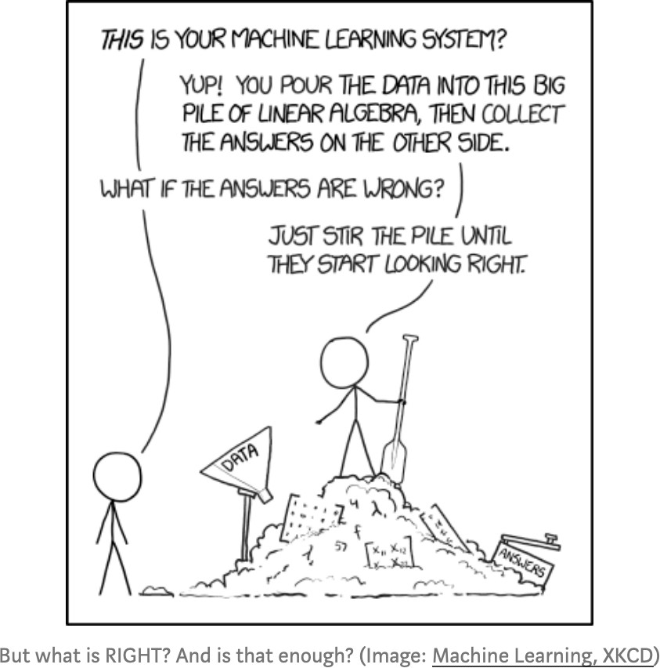
Importance of Linear Algebra in ML
Machine Learning

Slide 3
Topics in Linear Algebra for ML
Machine Learning
Why do we need Linear Algebra?
From scalars to tensors
Flow of tensors in ML
Matrix operations: determinant, inverse
Eigen values and eigen vectors
Singular Value Decomposition
Principal components analysis

Slide 4
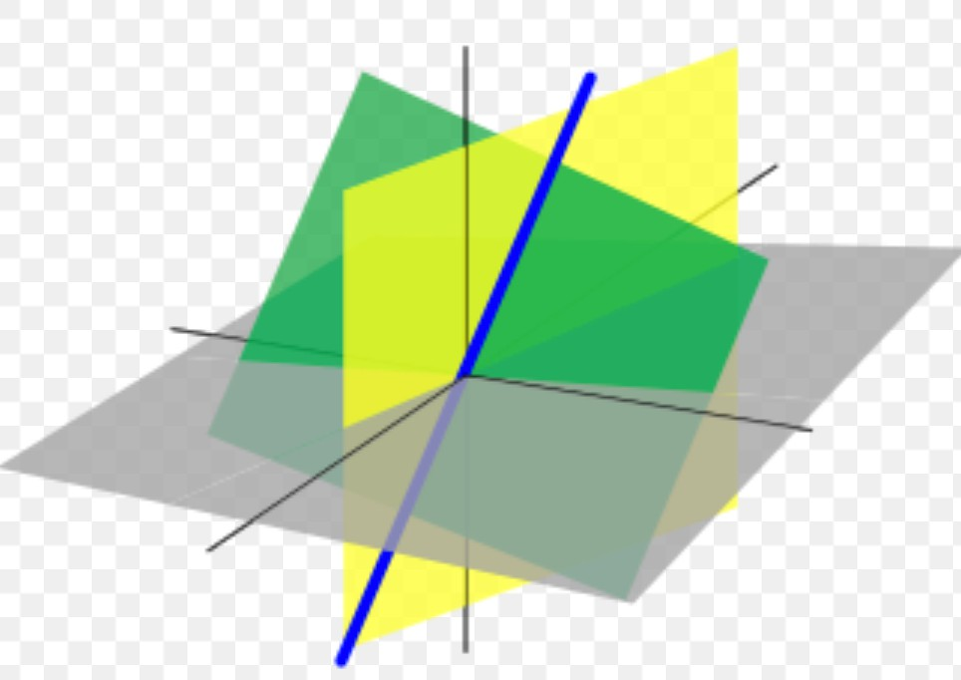
What is linear algebra?
Machine Learning
Linear algebra is the branch of mathematics concerning linear equations such as
a₁x₁+…..+a_{n}x_{n}=b
In vector notation we say a^{T}x=b
Called a linear transformation of x
Linear algebra is fundamental to geometry, for defining objects such as lines, planes, rotations
Linear equation a₁x₁+…..+a_{n}x_{n}=b defines a plane in (x₁,..,x_{n}) space Straight lines define common solutions to equations

Slide 5
Why do we need to know it?
Machine Learning
Linear Algebra is used throughout engineering
Because it is based on continuous math rather than discrete math
Computer scientists have little experience with it
Essential for understanding ML algorithms
E.g., We convert input vectors (x₁,..,x_{n}) into outputs by a series of linear transformations
Here we discuss:
Concepts of linear algebra needed for ML
Omit other aspects of linear algebra

Slide 6
Linear Algebra Topics
Machine Learning
Scalars, Vectors, Matrices and Tensors
Multiplying Matrices and Vectors
Identity and Inverse Matrices
Linear Dependence and Span
Norms
Special kinds of matrices and vectors
Eigendecomposition
Singular value decomposition
The Moore Penrose pseudoinverse
The trace operator
The determinant
Ex: principal components analysis
6

Slide 7
Scalar
Machine Learning
Single number
In contrast to other objects in linear algebra, which are usually arrays of numbers
Represented in lower-case italic x
They can be real-valued or be integers
E.g., let x ∈IR be the slope of the line
Defining a real-valued scalar
E.g., let n ∈N be the number of units
Defining a natural number scalar

Slide 8
Vector
Machine Learning
An array of numbers arranged in order
Each no. identified by an index
Written in lower-case bold such as x
– its elements are in italics lower case, subscripted
⎡ _{x} ⎤
⎢ ⎥
1
⎢ x ⎥
2
⎢ ⎥
⎥
x = ⎢
⎢ ⎥
⎢ _{x} ⎥
⎢ ⎥
n
⎢⎣ ⎥⎦
If each element is in R then x is in R
n
We can think of vectors as points in space
– Each element gives coordinate along an axis

Slide 9
Matrices
Machine Learning
2-D array of numbers
– So each element identified by two indices
Denoted by bold typeface A
Elements indicated by name in italic but not bold
A_{1,1} is the top left entry and A_{m,n} is the bottom right entry
We can identify nos in vertical column j by writing : for the horizontal coordinate
E.g.,
⎡ _{A}
A
⎤
⎥
A = ⎢
1,1
1,2
⎢ A
A
⎥
⎣ ⎦
2,1 2,2
A_{i:} is i^{th} row of A, A_{:j} is j^{th} column of A
If A has shape of height m and width n with real-
values then
_{A ∈1R}m×n

Slide 10
Tensor
Machine Learning
Sometimes need an array with more than two axes
E.g., an RGB color image has three axes
A tensor is an array of numbers arranged on a regular grid with variable number of axes
See figure next
Denote a tensor with this bold typeface: A
Element (i,j,k) of tensor denoted by A_{i,j,k}

Slide 11
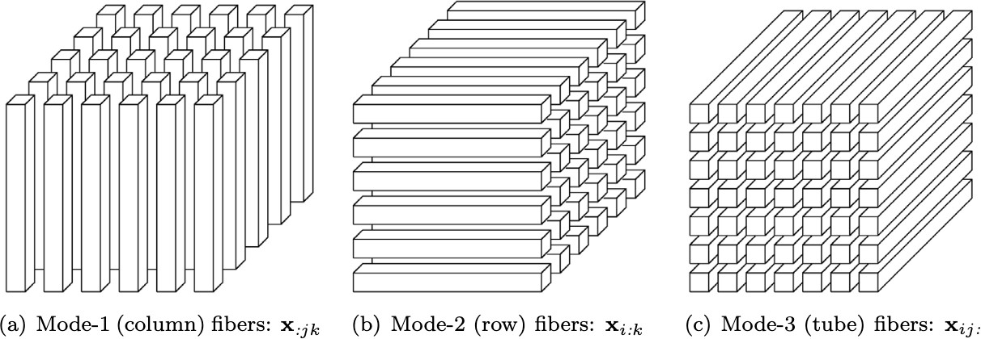
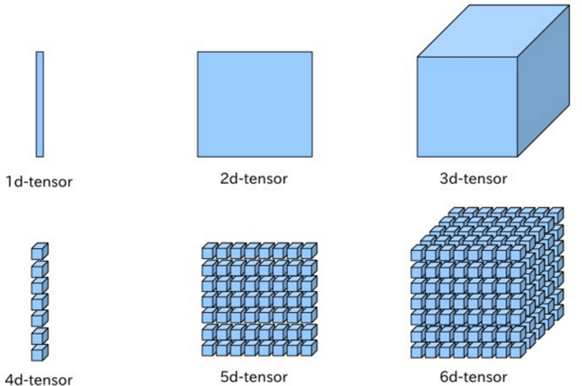
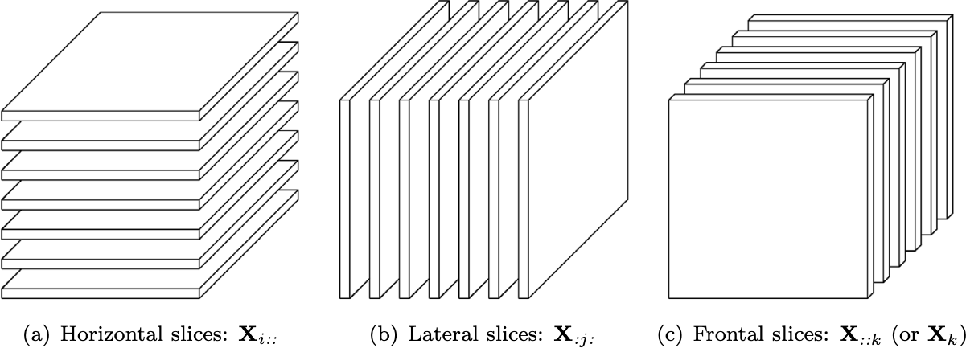
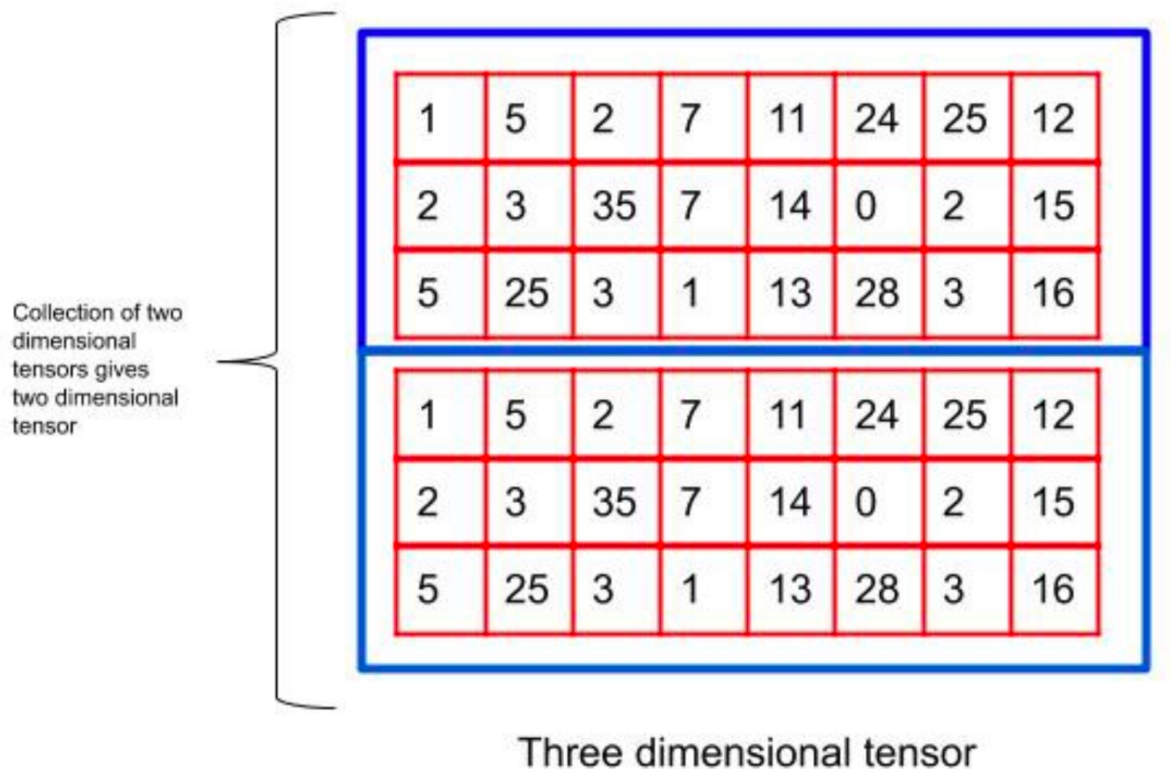
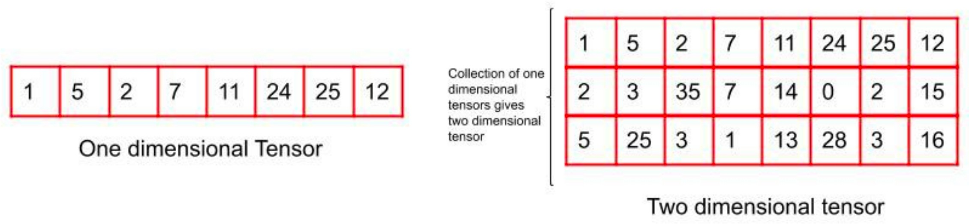
Dimensions of Tensors
Fibers of a 3rd order tensor
Machine Learning
0d-tensor (scalar)
Slices of a 3rd order tensor

Slide 12
Numpy library in Python for tensors
Machine Learning Srihari
Zero-dimensional tensor
import numpy as np x = np.array(100) print(“Array:”, x)
print(“Dimension:”, x.ndim)
Output
Array: 100
Dimension 0
One-dimensional tensor
import numpy as np
x = np.array([1,5,2,7,11,24,25,12])
print(“Array:”, x) print(“Dimension:”, x.ndim)
Output
Array: [ 1 5 2 7 11 24 25 12]
Dimension 1
Two-dimensional tensor
import numpy as np x = np.array(
[
[1,5,2,7,11,24,25,12],
[1,2,3,4,5,6,7,8]
]
)
print(“Array:”, x) print(“Dimension:”, x.ndim)
Output
Array: [[ 1 5 2 7 11 24 25 12] [ 1 2 3 4
5 6 7 8]]
Dimension 2

Slide 13
Transpose of a Matrix
Machine Learning
Srihari
An important operation on matrices
The transpose of a matrix A is denoted as A^{T}
Defined as
^{(AT)}i,j^{=A}j,i
The mirror image across a diagonal line
Called the main diagonal , running down to the right starting from upper left corner
⎡ _{A}
A A
⎤
⎡ _{A}
A A
⎤
⎥
⎥
⎥
⎡ _{A}
A
⎤
⎡ _{A}
A A
⎤
⎥
⎥
⎥
⎢
1,1
1,2
1,3
⎥
⎢
1,1
2,1
3,1
⎢
1,1
1,2
⎥
⎢
1,1
2,1
3,1
A = ⎢ A A A ⎥ ⇒ A^{T} = ⎢ A
A A
A = ⎢ A A
⎥ ⇒ A^{T} = ⎢ A A A
2,3
⎢ A A A
3,1 3,2 3,3
⎢
2,1
2,2
⎥
⎢
1,2
2,2
3,2
⎢
2,1
2,2
⎥
⎢
1,2
2,2
3,2
⎥
⎥
⎢ A A
1,3 2,3
^{A}3,3
⎥
⎢ A A
3,1 3,2
⎢
⎥
⎣
⎦
⎣
⎦
⎣
⎦
⎣
⎦

Slide 14
Vectors as special case of matrix
Machine Learning
Vectors are matrices with a single column
Often written in-line using transpose
x = [x₁,..,x_{n}]^{T}
⎡ _{x} ⎤
⎢ ⎥
1
⎢ x ⎥
2
x = ⎢
⎢ ⎥
T
⎤
⎥
⇒ x = ⎡x ,x ,..x
⎢ ⎥
⎢ _{x} ⎥
⎣ 1 2 n ⎦
⎢ n ⎥
⎢⎣ ⎥⎦
A scalar is a matrix with one element
a=a^{T}

Slide 15
Matrix Addition
Machine Learning
We can add matrices to each other if they have the same shape, by adding corresponding elements
– If A and B have same shape (height m, width n)
C =A+B ⇒C_{i,j} = A_{i,j} +B_{i,j}
A scalar can be added to a matrix or multiplied
by a scalar
D=aB+c ⇒ D_{i,j} =aB_{i,j} +c
Less conventional notation used in ML:
– Vector added to matrix
C =A+b ⇒C_{i,j} =A_{i,j} +b_{j}
Called broadcasting since vector b added to each row of A

Slide 16
Multiplying Matrices
Machine Learning
For product C=AB to be defined, A has to have the same no. of columns as the no. of rows of B
– If A is of shape mxn and B is of shape nxp then
matrix product C is of shape mxp
C =AB ⇒C_{i,j} = ∑A_{i,k}B_{k,j}
k
Note that the standard product of two matrices is not just the product of two individual elements
Such a product does exist and is called the element-wise product or the Hadamard product A0B

Slide 17
Multiplying Vectors
Machine Learning
Dot product between two vectors x and y of same dimensionality is the matrix product x^{T}y
We can think of matrix product C=AB as computing C_{ij} the dot product of row i of A and column j of B

Slide 18
Matrix Product Properties
Machine Learning
Distributivity over addition: A(B+C)=AB+AC
Associativity: A(BC)=(AB)C
Not commutative: AB=BA is not always true
Dot product between vectors is commutative:
x^{T}y=y^{T}x
Transpose of a matrix product has a simple form: (AB)^{T}=B^{T}A^{T}

Slide 19
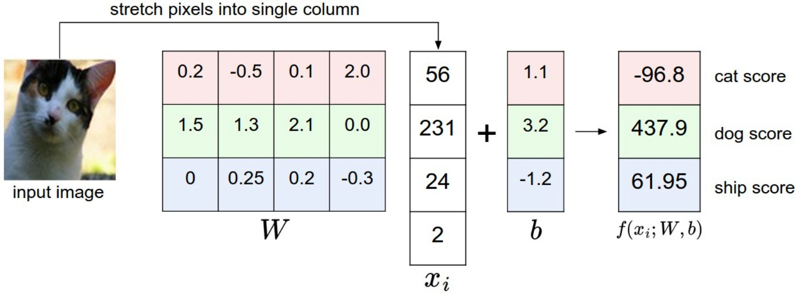
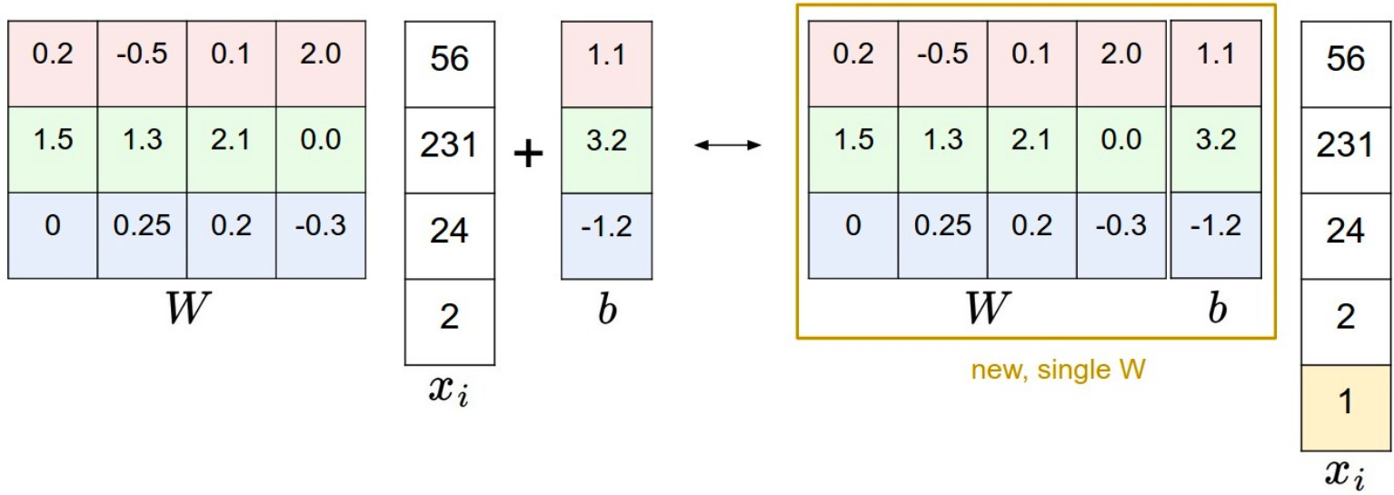
Example flow of tensors in ML
Machine Learning
A linear classifier y= Wx^{T}+b
Vector x is converted into vector y by
multiplying x by a matrix W
A linear classifier with bias eliminated y= Wx^{T}

Slide 20
Linear Transformation
Machine Learning
Ax=b
– where A ∈Il{^{n×n} and b ∈Il{^{n}
– More explicitly
A₁₁x₁ + A₁₂ x₂ + ....+ A_{1n} x_{n} = b₁ A₂₁x₁ + A₂₂ x₂ + ....+ A_{2n} x_{n} = b₂
A_{n1}x₁ + A_{m2} x₂ + ....+ A_{n,n} x_{n} = b_{n}
n equations in
n unknowns
⎡ ⎢ | A | . | A | ⎤ ⎥ | ⎡ ⎢ | x | ⎤ ⎥ | ⎡ ⎢ | b | ⎤ ⎥
A = ⎢ ⎢ |  |  |  | ⎥ ⎥ | x = ⎢ ⎢ |  | ⎥ ⎥ | b = ⎢ ⎢ |  | ⎥ ⎥
⎢⎣ | A . |  | A |  | x |  | ⎥⎦ | b |  | ⎥⎦
 | n x n |  |  |  | n x 1 |  |  | n x |  | 1
Can view A as a linear transformation
of vector x to vector b
1,1
1,n
1
1
n,1
nn
⎥⎦
⎢⎣
n
⎢⎣
n
Sometimes we wish to solve for the unknowns
x ={x₁,..,x_{n}} when A and b provide constraints
20

Slide 21
Identity and Inverse Matrices
Machine Learning
Matrix inversion is a powerful tool to analytically solve Ax=b
Needs concept of Identity matrix
Identity matrix does not change value of vector when we multiply the vector by identity matrix
– Denote identity matrix that preserves n-dimensional vectors as I_{n}
Formally
Example of I
_{I ∈!R}n×n
and
∀x ∈"/^{n} ,I x = x
n
n
⎡
⎢
⎢
1 | 0
0 | 1
0 | 0
₀ ⎤
3
₀ ⎥
⎥
⎢
1 ⎥
21
⎣
⎦

Slide 22
Matrix Inverse
Machine Learning
Srihari
Inverse of square matrix A defined as
We can now solve Ax=b as follows:
Ax = b
A⁻¹ Ax = A⁻¹b
−1
I_{n} x = A b
x = A⁻¹b
A⁻¹ A = I
n
This depends on being able to find A⁻¹
If A⁻¹ exists there are several methods for finding it

Slide 23
Solving Simultaneous equations
Machine Learning
Srihari
Ax = b
where A is (M+1) x (M+1)
x is (M+1) x 1: set of weights to be determined
b is N x 1

Slide 24
^{Machine Learning}Example: System of Linear Equations in Linear Regression
Srihari
Instead of Ax=b
We have
Φw = t
where Φ is m x n design matrix of m features for n
samples x_{j}, j=1,..n
w is weight vector of m values
t is target values of sample, t=[t₁,..t_{n}]
We need weight w to be used with m features to determine output
m
y(x,w)=∑w_{i}x_{i}
i=1
24

Slide 25
Closed-form solutions
Machine Learning
Srihari
Two closed-form solutions
Matrix inversion x=A⁻¹b
Gaussian elimination
25

Slide 26
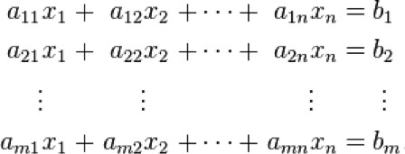
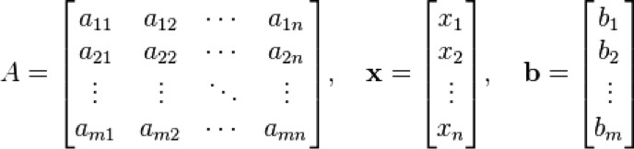
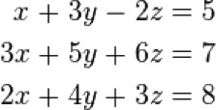
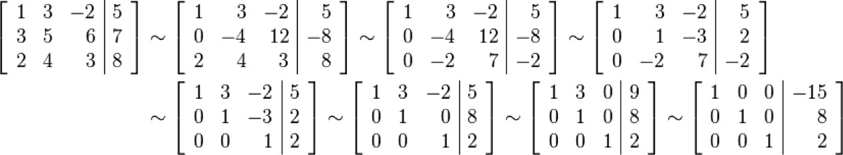
Linear Equations: Closed-Form Solutions
Machine Learning Srihari
1. Matrix Formulation: Ax=b
Solution: x=A⁻¹b
2. Gaussian Elimination followed by back-substitution
L₂-3L₁➔L₂
L₃-2L₁➔L₃
-L₂/4➔L₂

Slide 27
Disadvantage of closed-form solutions
Machine Learning Srihari
If A⁻¹ exists, the same A⁻¹ can be used for any given b
But A⁻¹ cannot be represented with sufficient precision
It is not used in practice
Gaussian elimination also has disadvantages
numerical instability (division by small no.)
O(n³) for n x n matrix
Software solutions use value of b in finding x
E.g., difference (derivative) between b and output is
used iteratively

Slide 28
How many solutions for Ax=b exist?
Machine Learning
Srihari
System of equations with
– n variables and m equations is:
Solution is x=A⁻¹b
A₁₁x₁ + A₁₂ x₂ + ....+ A_{1n} x_{n} = b₁ A₂₁x₁ + A₂₂ x₂ + ....+ A_{2n} x_{n} = b₂
A_{m1}x₁ + A_{m2} x₂ + ....+ A_{mn} x_{n} = b_{m}
In order for A⁻¹ to exist Ax=b must have exactly
one solution for every value of b
It is also possible for the system of equations to have no solutions or an infinite no. of solutions for some values of b
It is not possible to have more than one but fewer than infinitely many solutions
If x and y are solutions then z=α x + (1-α) y is a
solution for any real α

Slide 29
Span of a set of vectors
Machine Learning Srihari
Span of a set of vectors: set of points obtained by a linear combination of those vectors
– A linear combination of vectors {v⁽¹⁾,.., v^{(n)}} with
coefficients c_{i} is
∑
i
c v
(i)
i
System of equations is Ax=b
A column of A, i.e., A_{:i} specifies travel in direction i
How much we need to travel is given by x_{i}
This is a linear combination of vectors
Ax = ∑x_{i}A_{:, i}
i
Thus determining whether Ax=b has a solution is equivalent to determining whether b is in the span of columns of A
This span is referred to as column space or range of A

Slide 30
Conditions for a solution to Ax=b
Machine Learning
Srihari
Matrix must be square, i.e., m=n and all columns must be linearly independent
– Necessary condition is ^{n ≥m}
For a solution to exist when A ∈]]{^{m×n}
column space be all of !R^{m}
– Sufficient Condition
we require the
If columns are linear combinations of other columns, column space is less than !R^{m}
– Columns are linearly dependent or matrix is singular
For column space to encompass !R^{m} at least one set of m linearly independent columns
For non-square and singular matrices
– Methods other than matrix inversion are used

Slide 31
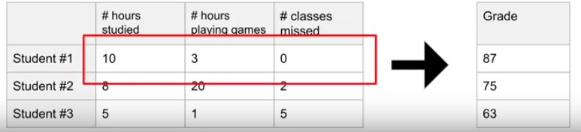
Use of a Vector in Regression
Machine Learning
Srihari
A design matrix
– N samples, D features
Feature vector has three dimensions
This is a regression problem

Slide 32
Norms
Machine Learning Srihari
Used for measuring the size of a vector
Norms map vectors to non-negative values
Norm of vector x = [x₁,..,x_{n}]^{T} is distance from origin to x
– It is any function f that satisfies:
f (x )= 0 ⇒ x = 0
f( x +y) ≤ f (x )+ f (y )
∀α ∈R f (αx )= α f (x )
Triangle Inequality

Slide 33
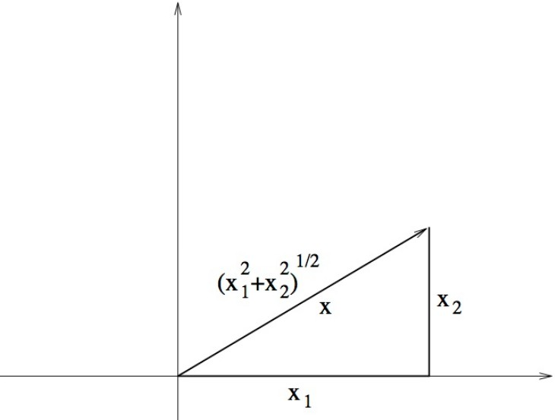
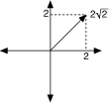


L^{P} Norm
Machine Learning
Srihari
Definition:
1
_{p ⎞} p
i ⎟⎠
x = ⎛ ∑ x
⎜⎝
p
i
– L² Norm
Called Euclidean norm
Simply the Euclidean distance between the origin and the point x
written simply as ||x||
Squared Euclidean norm is same as x^{T}x
– L¹ Norm
2² + 2² = 8 = 2 2
Useful when 0 and non-zero have to be distinguished
– Note that L² increases slowly near origin, e.g., 0.1²=0.01)
– L∞ Norm
x =max x_{i}
∞
i
Called max norm
33

Slide 34
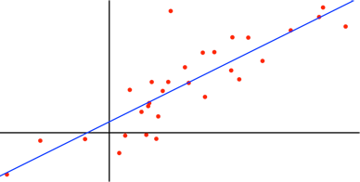
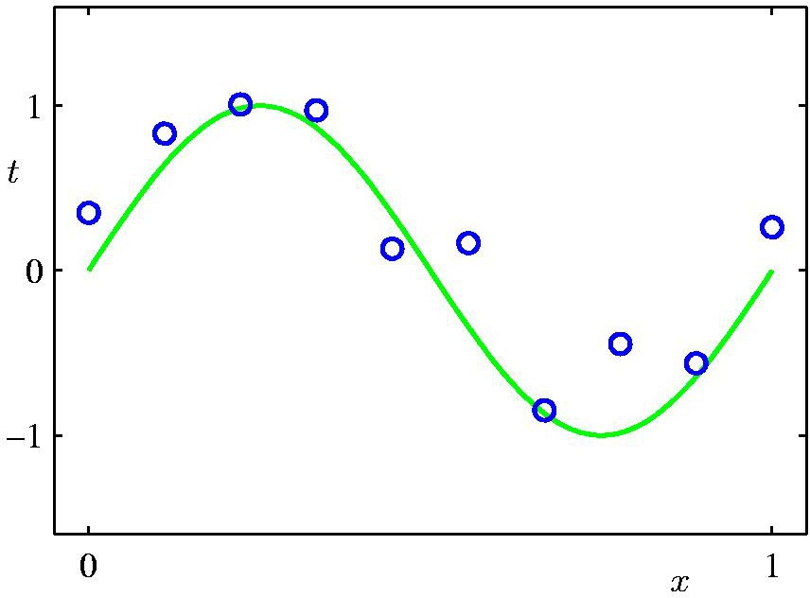
Use of norm in Regression
Machine Learning
Srihari
Linear Regression
x: a vector, w: weight vector
y(x,w) = w₀+w₁x₁+..+w_{d} x_{d} = w^{T}x
With nonlinear basis functions ϕ_{j}
M −1
y(x,w) = w₀ + ∑ w_{j}ϕ_{j} (x)
j =1
Loss Function
E�(w) = ¹ ∑{y(x ,w) − t }² + ^{λ} || w² ||
N
² n =1
n n
2
Second term is a weighted norm
called a regularizer (to prevent overfitting)
34

Slide 35
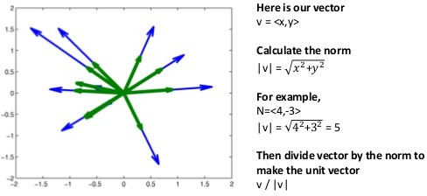
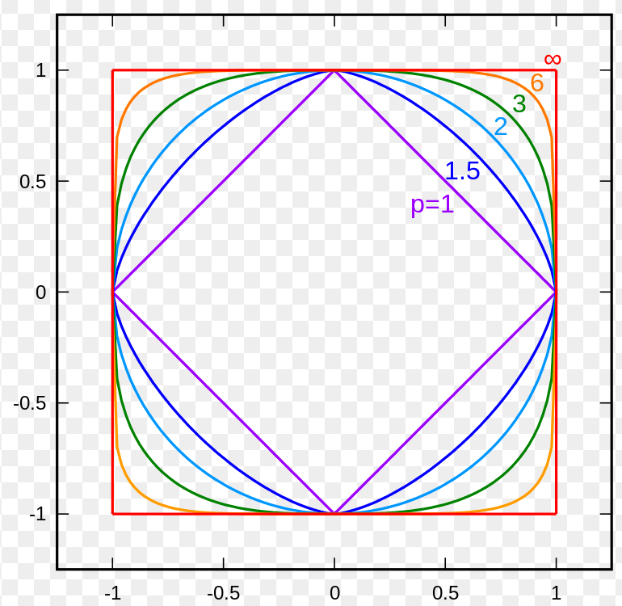
L^{P} Norm and Distance
Machine Learning
Srihari
Norm is the length of a vector
We can use it to draw a unit circle from origin
Different P values yield different shapes
Euclidean norm yields a circle
Distance between two vectors (v,w)
dist(v,w)=||v-w||
=
(v − w )² + .. + (v − w )²
1 1 n n
Distance to origin would just be sqrt of sum of squares
35

Slide 36
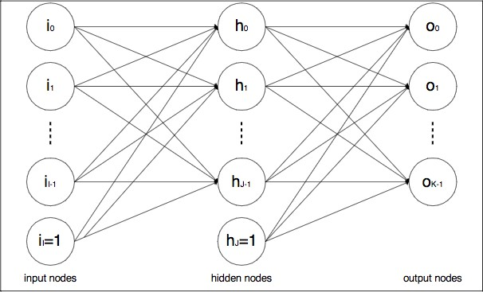
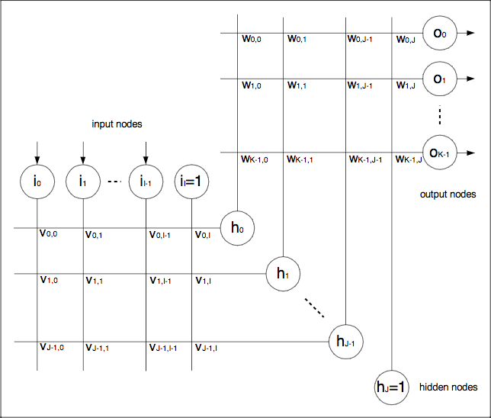

Size of a Matrix: Frobenius Norm
Machine Learning
Srihari
Similar to L² norm
Frobenius in ML
Layers of neural network involve matrix multiplication
Regularization:
minimize Frobenius of weight matrices ||W(i)|| over L layers
1
₌ ⎛
_{A2 ⎞} 2
A
⎜⎝ ∑ i,j ⎟⎠
F
i,j
⎡ ₂ ₅ ⎤
A = 4 + 1 + 25 + .. + 1 = 46
−1
A = ⎢ 0 2
₁ ⎥
⎢
⎢⎣ 3 1 1 ⎥⎦
⎥
V matrix
W matrix
I
J K
I1×(I+1) × V(I+1)×J=netJ
h_{j}=f(net_{j}) f(x)=1/(1+e^{-x})
36

Slide 37
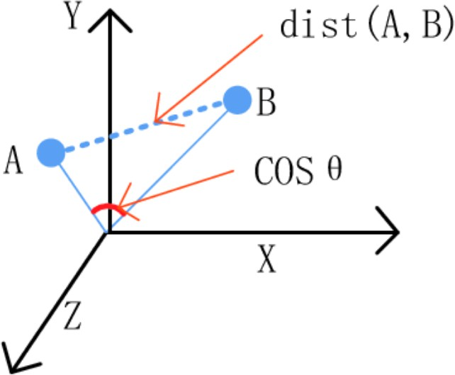
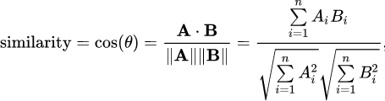
Angle between Vectors
Machine Learning
Srihari
Dot product of two vectors can be written in terms of their L² norms and angle θ between them
x ^{T}y ⇒||x || ||y || cos θ
2 2
Cosine between two vectors is a measure of their similarity
37

Slide 38
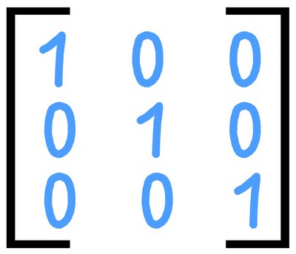
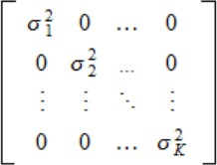
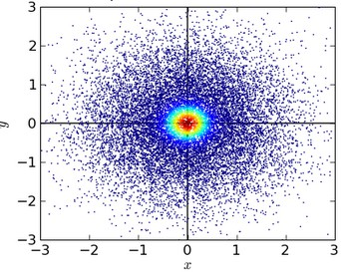
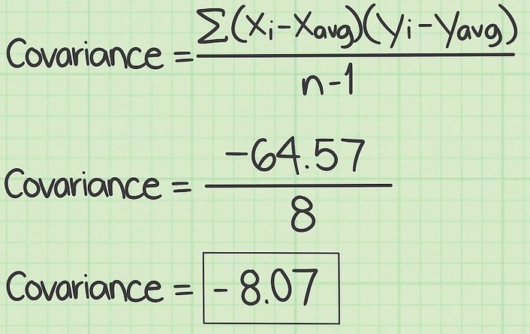
Special kind of Matrix: Diagonal
Machine Learning
Srihari
Diagonal Matrix has mostly zeros, with non- zero entries only in diagonal
E.g., identity matrix, where all diagonal entries are 1
E.g., covariance matrix with independent features
If Cov(X,Y)=0 then E(XY)=E(X)E(Y)
N(x | µ,Σ) = ¹ ¹ exp ⎧⎪⎨− ¹ (x − µ)^{T} Σ⁻¹(x − µ)⎫⎪⎬
(2π)^{D/2} | Σ |^{1/2} 2
⎪⎩ ⎪⎭

Slide 39
Efficiency of Diagonal Matrix
Machine Learning
Srihari
diag (v) denotes a square diagonal matrix with diagonal elements given by entries of vector v
Multiplying vector x by a diagonal matrix is efficient
– To compute diag(v)x we only need to scale each x_{i}
by v_{i}
diag( v )x = v Ox
Inverting a square diagonal matrix is efficient
– Inverse exists iff every diagonal entry is nonzero, in which case diag (v)⁻¹=diag ([1/v₁,..,1/v_{n}]^{T})

Slide 40
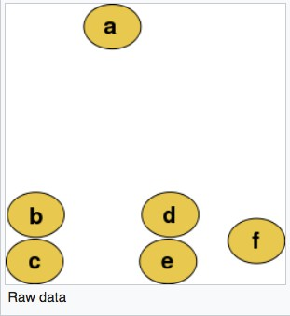
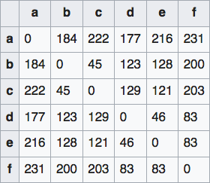
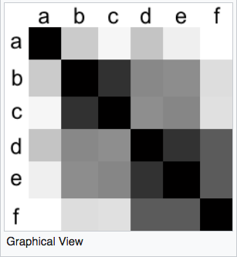

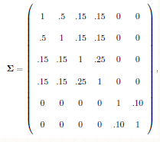
Special kind of Matrix: Symmetric
Machine Learning Srihari
A symmetric matrix equals its transpose: A=A^{T}
– E.g., a distance matrix is symmetric with A_{ij}=A_{ji}
– E.g., covariance matrices are symmetric

Slide 41

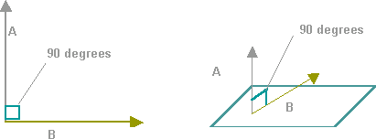
Special Kinds of Vectors
Machine Learning
Srihari
Unit Vector
– A vector with unit norm
Orthogonal Vectors
x =1
2
A vector x and a vector y are orthogonal to each other if x^{T}y=0
If vectors have nonzero norm, vectors at
90 degrees to each other
Orthonormal Vectors
Vectors are orthogonal & have unit norm
Orthogonal Matrix
– A square matrix whose rows are mutually
orthonormal: A^{T}A=AA^{T}=I _{A}-1_{=A}T
Orthogonal matrices are of interest because their inverse is very cheap to compute
–

Slide 42
Matrix decomposition
Machine Learning
Srihari
Matrices can be decomposed into factors to learn universal properties, just like integers:
– Properties not discernible from their representation
Decomposition of integer into prime factors
From 12=2×2×3 we can discern that
12 is not divisible by 5 or
any multiple of 12 is divisible by 3
But representations of 12 in binary or decimal are different
Decomposition of Matrix A as A=Vdiag(λ)V⁻¹
where V is formed of eigenvectors and λ are eigenvalues, e.g,
⎡ ⎤
_{A =} 2 1
has eigenvalues λ=1 and λ=3 and eigenvectors V:
⎡
v =
1
⎤
,v
⎡ ⎤
₌ 1
⎢
⎥
⎢
⎥
⎢ ⎥
⎢ ₁ ₂ ⎥
λ=1
⎢ ₋₁ ⎥
λ=3
⎢ ₁ ⎥
⎣
⎦
⎣
⎦
⎣ ⎦

Slide 43
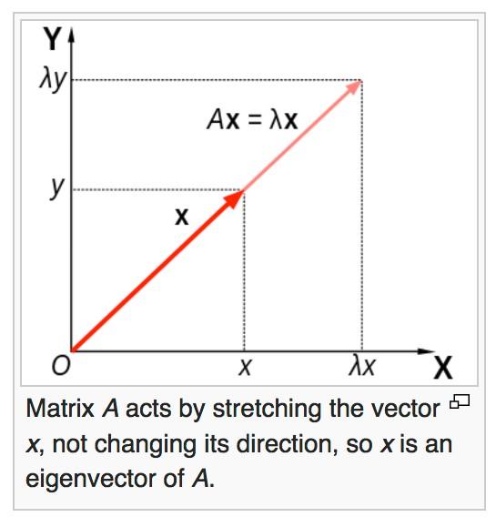
Eigenvector
Machine Learning
Srihari
An eigenvector of a square matrix A is a non-zero vector v such that multiplication by A only changes the scale of v
Av=λv
– The scalar λ is known as eigenvalue
If v is an eigenvector of A, so is any rescaled vector sv. Moreover sv still has the same eigen value. Thus look for a unit eigenvector
Wikipedia
43

Slide 44
Eigenvalue and Characteristic Polynomial
Machine Learning Srihari
L A
A= ⎢ M M M
L
⎡ _{A}
⎤
⎥
⎥
⎡ _{v} ⎤ ⎡ _{w} ⎤
⎢
1,1
1,n
⎢ ⎥
⎢ ⎥
⎥
⎥⎦
⎢ ⎥
Consider Av=w
⎢
1
1
⎥
⎦
v = ⎢ M
w = ⎢
⎢ M ⎥
⎢ ^{A}n,1
^{A}nn ⎥
⎢⎣ v_{n}
⎢⎣ w_{n}
⎥
⎥⎦
⎣
If v and w are scalar multiples, i.e., if Av=λv
then v is an eigenvector of the linear transformation A and the scale factor λ is the eigenvalue corresponding to the eigen vector
This is the eigenvalue equation of matrix A
– Stated equivalently as (A-λI)v=0
This has a non-zero solution if |A-λI|=0
The polynomial of degree n can be factored as
|A-λI| = (λ₁-λ)(λ₂-λ)…(λ_{n}-λ)
as
The λ₁, λ₂…λ_{n} are roots of the polynomial and are eigenvalues of A

Slide 45
Example of Eigenvalue/Eigenvector
Machine Learning Srihari
Consider the matrix
⎡ ₂ ₁ ⎤
A = ⎢
⎥
⎢ ₁ ₂ ⎥
⎣ ⎦
Taking determinant of (A-λI), the char poly is
⎡ ⎤
| A −λI |= ^{2 −λ}
⎢
1
⎥
= 3 − 4λ + λ
2
⎢
1 2 −λ ⎥
⎣ ⎦
It has roots λ=1 and λ=3 which are the two eigenvalues of A
The eigenvectors are found by solving for v in
Av=λv, which are
⎡
v =
1
⎤
,v
⎡ ⎤
₌ 1
⎢
⎥
⎢ ⎥
λ=1
⎢ ₋₁ ⎥
λ=3
⎢ ₁ ⎥
⎣
⎦
⎣ ⎦
45

Slide 46
Eigendecomposition
Machine Learning
Srihari
Suppose that matrix A has n linearly independent eigenvectors {v⁽¹⁾,..,v^{(n)}} with eigenvalues {λ₁,..,λ_{n}}
Concatenate eigenvectors to form matrix V
Concatenate eigenvalues to form vector
λ=[λ₁,..,λ_{n}]
Eigendecomposition of A is given by
A=Vdiag(λ)V⁻¹
46

Slide 47
Decomposition of Symmetric Matrix
Machine Learning Srihari
Every real symmetric matrix A can be decomposed into real-valued eigenvectors and eigenvalues
A=QΛQ^{T}
where Q is an orthogonal matrix composed of eigenvectors of A: {v⁽¹⁾,..,v^{(n)}}
orthogonal matrix: components are orthogonal or v^{(i)T}v^{(j)}=0
Λ is a diagonal matrix of eigenvalues {λ₁,..,λ_{n}}
We can think of A as scaling space by λ_{i} in direction v^{(i)}
–See figure on next slide
47

Slide 48
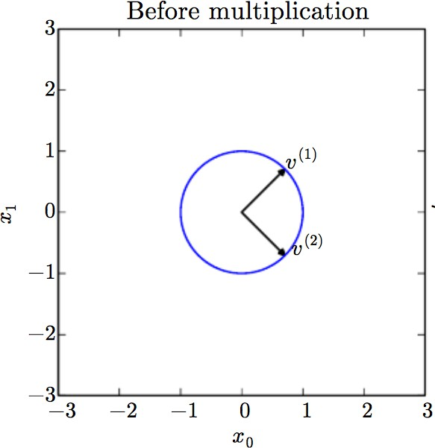
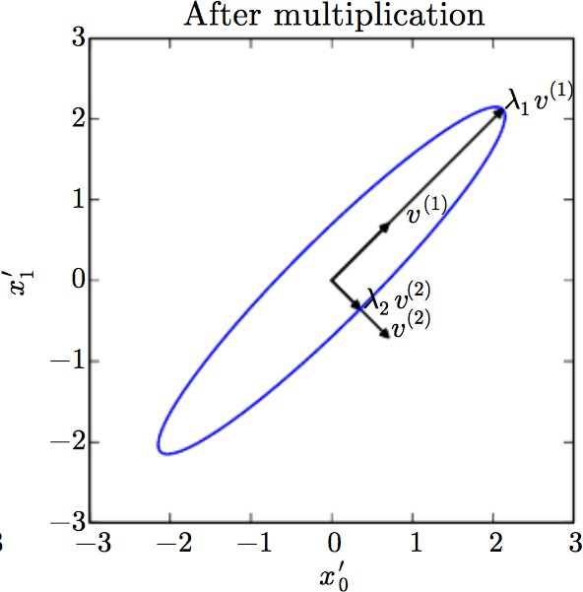
Effect of Eigenvectors and Eigenvalues
Machine Learning
Srihari
Example of 2×2 matrix
Matrix A with two orthonormal eigenvectors
– v⁽¹⁾ with eigenvalue λ₁, v⁽²⁾ with eigenvalue λ₂
Plot of unit vectors u ∈lR²
(circle)
Plot of vectors Au
(ellipse)
with two variables x₁ and x₂

Slide 49
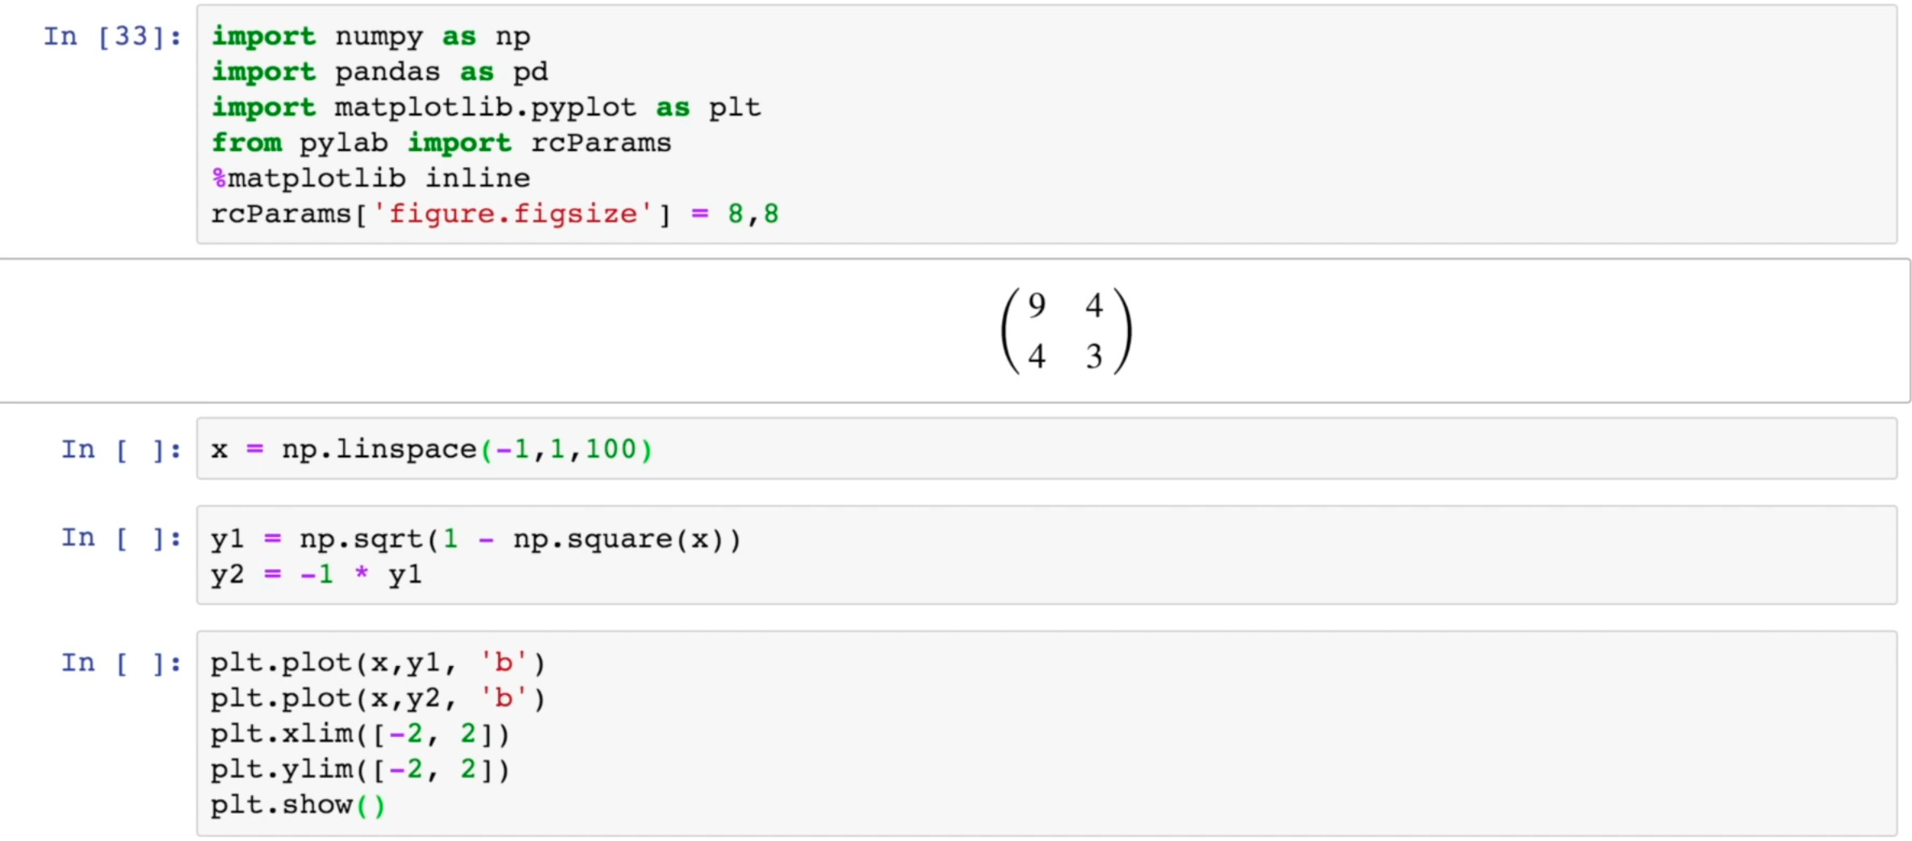
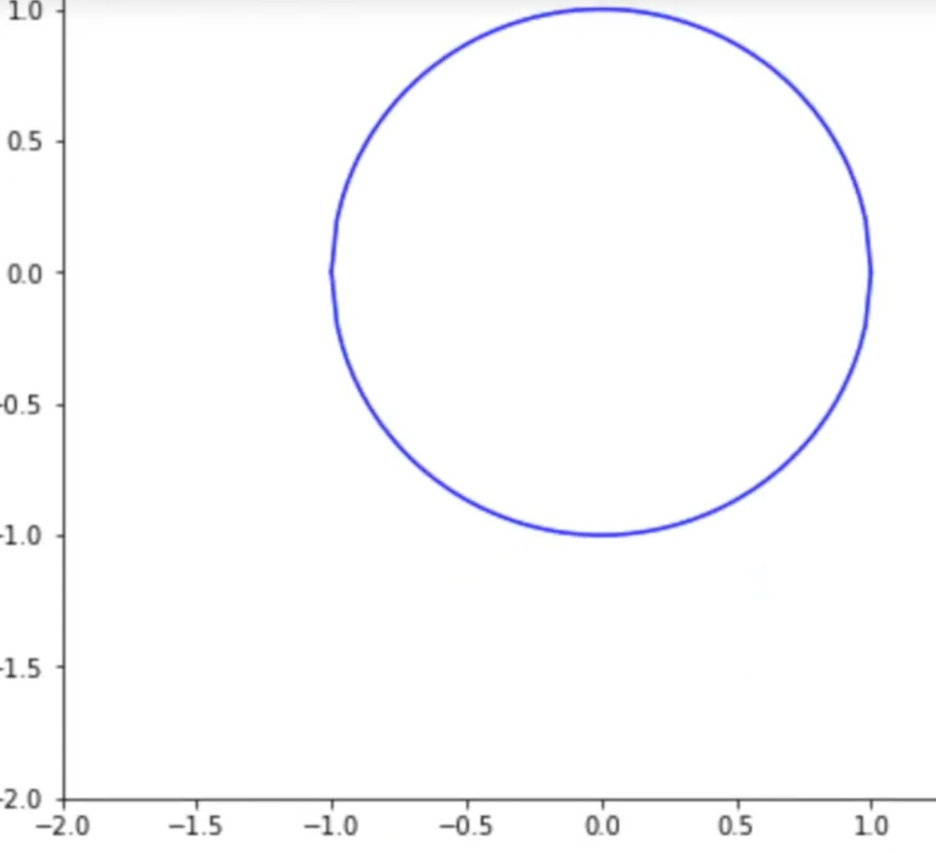
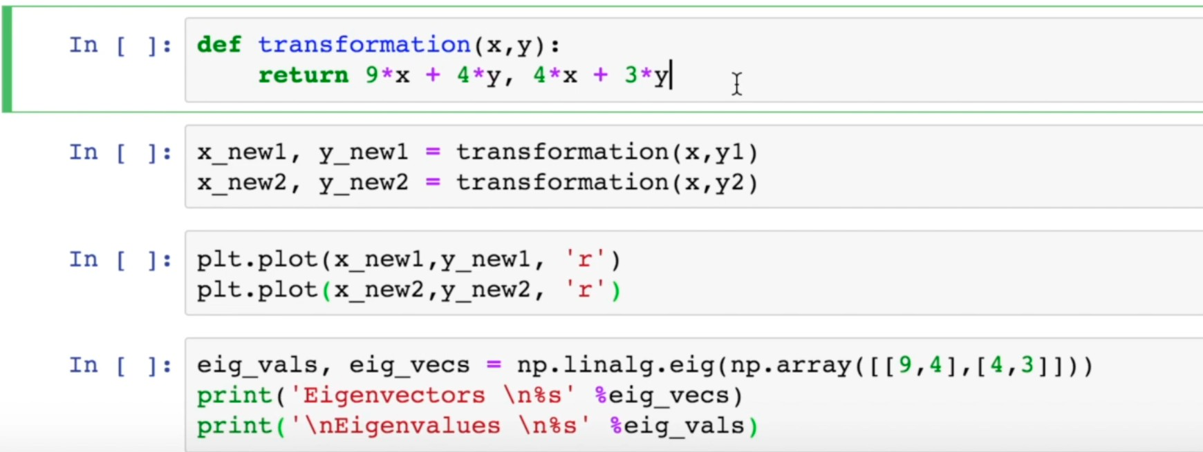
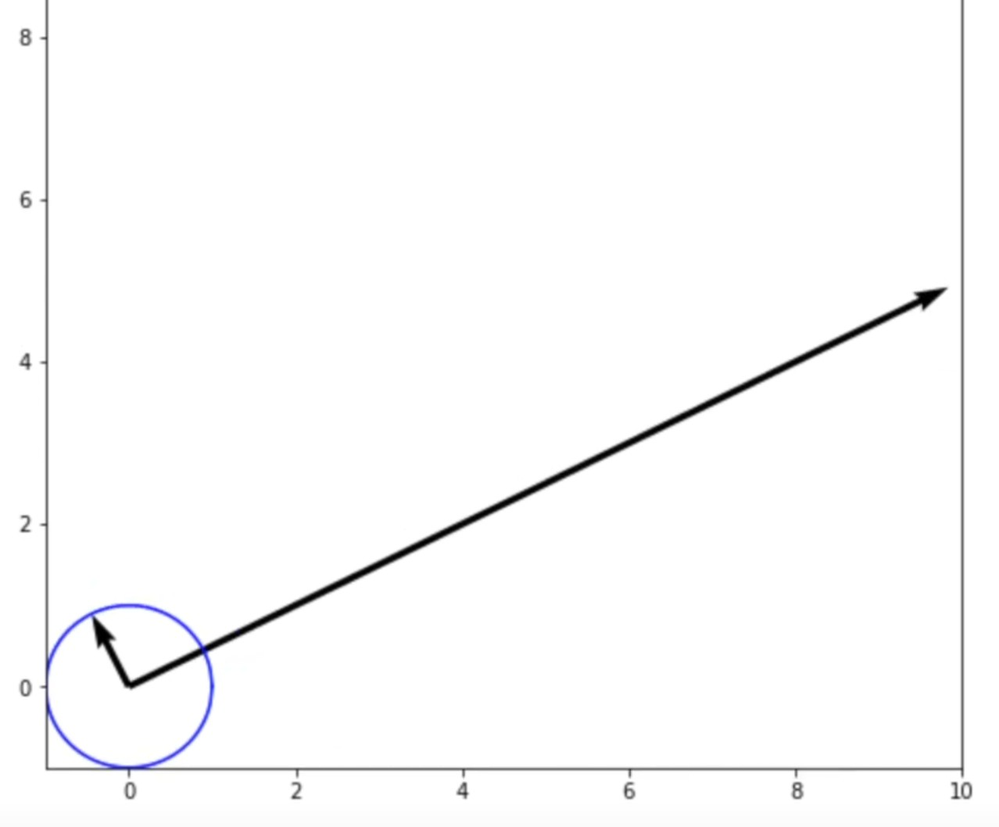
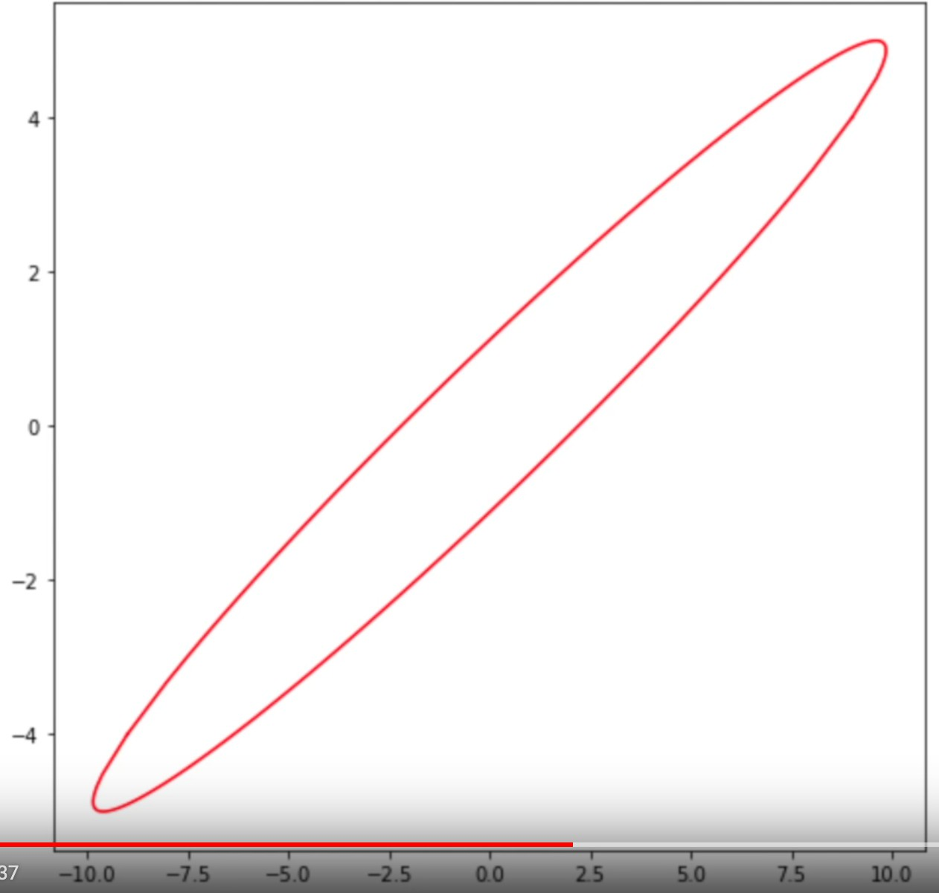
Python Code for Eigenvalue/Eigenvector
Machine Learning
Srihari
https://www.youtube.com/watch?v=mxkGMbrobY0&feature=youtu.be&fbclid=IwAR3ajOaxWmn V-rYnAa6cwYfq9j6is6-H8UhnIMCkhBu3Cqfvby_vicyU2fg

Slide 50
Eigendecomposition is not unique
Machine Learning
Srihari
Eigendecomposition is A=QΛQ^{T}
where Q is an orthogonal matrix composed of eigenvectors of A
Decomposition is not unique when two eigenvalues are the same
By convention order entries of Λ in descending order:
Under this convention, eigendecomposition is unique if all eigenvalues are unique

Slide 51
What does eigendecomposition tell us?
Machine Learning
Srihari
Tells us useful facts about the matrix:
Matrix is singular if & only if any eigenvalue is zero
Useful to optimize quadratic expressions of form
f(x)=x^{T}Ax subject to ||x||₂=1
Whenever x is equal to an eigenvector, f is equal to the corresponding eigenvalue
Maximum value of f is max eigen value, minimum value is min eigen value
Example of such a quadratic form appears in multivariate Gaussian
N(x | µ,Σ) = ¹ ¹ exp ⎧⎪⎪
1
T −1
⎪
⎨− (x − µ) Σ (x − µ)⎬
⎪ 2
(2π)^{D/2} | Σ |^{1/2}
⎩
⎪⎭

Slide 52
Positive Definite Matrix
Machine Learning Srihari
A matrix whose eigenvalues are all positive is called positive definite
Positive or zero is called positive semidefinite
If eigen values are all negative it is negative definite
Positive definite matrices guarantee that x^{T}Ax ≥ 0

Slide 53
Singular Value Decomposition (SVD)
Machine Learning
Srihari
Eigendecomposition has form: A=Vdiag(λ)V⁻¹
If A is not square, eigendecomposition is undefined
SVD is a decomposition of the form A=UDV^{T}
SVD is more general than eigendecomposition
Used with any matrix rather than symmetric ones
Every real matrix has a SVD
Same is not true of eigen decomposition

Slide 54
SVD Definition
Machine Learning
Srihari
Write A as a product of 3 matrices: A=UDV^{T}
– If A is m×n, then U is m×m, D is m×n, V is n×n
Each of these matrices have a special structure
U and V are orthogonal matrices
D is a diagonal matrix not necessarily square
Elements of Diagonal of D are called singular values of A
Columns of U are called left singular vectors
Columns of V are called right singular vectors
SVD interpreted in terms of eigendecomposition
Left singular vectors of A are eigenvectors of AA^{T}
Right singular vectors of A are eigenvectors of A^{T}A
Nonzero singular values of A are square roots of eigen values of A^{T}A. Same is true of AA^{T}

Slide 55
Use of SVD in ML
Machine Learning
Srihari
1. SVD is used in generalizing matrix inversion
– Moore-Penrose inverse (discussed next)
Used in Recommendation systems
Collaborative filtering (CF)
Method to predict a rating for a user-item pair based on the history of ratings given by the user and given to the item
Most CF algorithms are based on user-item rating matrix where each row represents a user, each column an item
– Entries of this matrix are ratings given by users to items
SVD reduces no.of features of a data set by reducing space dimensions from N to K where K < N

Slide 56
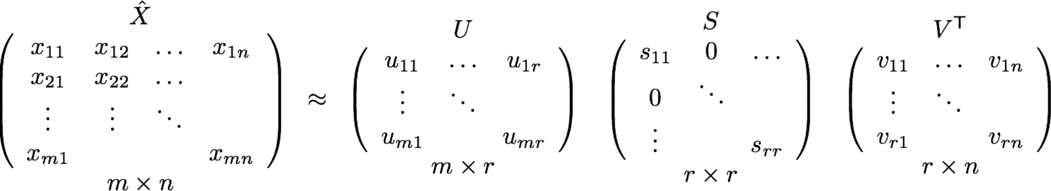
SVD in Collaborative Filtering
Machine Learning
Srihari
X is the utility matrix
X_{ij} denotes how user i likes item j
CF fills blank (cell) in utility matrix that has no entry
Scalability and sparsity is handled using SVD
SVD decreases dimension of utility matrix by extracting its latent factors
Map each user and item into latent space of dimension r

Slide 57
Moore-Penrose Pseudoinverse
Machine Learning Srihari
Most useful feature of SVD is that it can be used to generalize matrix inversion to non- square matrices
Practical algorithms for computing the pseudoinverse of A are based on SVD
A⁺=VD⁺U^{T}
where U,D,V are the SVD of A
Pseudoinverse D⁺ of D is obtained by taking the reciprocal of its nonzero elements when taking transpose of resulting matrix

Slide 58
Trace of a Matrix
Machine Learning Srihari
Trace operator gives the sum of the elements along the diagonal
Tr( A )= ∑ A_{i ,i}
i ,i
Frobenius norm of a matrix can be represented as
( )
1
2
A = Tr( A)
F

Slide 59
Determinant of a Matrix
Machine Learning
Srihari
Determinant of a square matrix det(A) is a mapping to a scalar
It is equal to the product of all eigenvalues of the matrix
Measures how much multiplication by the matrix expands or contracts space

Slide 60
Example: PCA
Machine Learning Srihari
A simple ML algorithm is Principal Components Analysis
It can be derived using only knowledge of basic linear algebra

Slide 61
PCA Problem Statement
Machine Learning Srihari
Given a collection of m points {x⁽¹⁾,..,x^{(m)}} in R^{n}
represent them in a lower dimension.
For each point x^{(i)} find a code vector c^{(i)} in R^{l}
If l is smaller than n it will take less memory to store the points
This is lossy compression
Find encoding function f (x) = c and a decoding function x ≈ g ( f (x) )

Slide 62
PCA using Matrix multiplication
Machine Learning
Srihari
One choice of decoding function is to use
matrix multiplication: g(c) =Dc where
– D is a matrix with l columns
To keep encoding easy, we require columns of
D to be orthogonal to each other
– To constrain solutions we require columns of D to have unit norm
We need to find optimal code c* given D
Then we need optimal D
_{D ∈�}n×l

Slide 63
Finding optimal code given D
Machine Learning Srihari
To generate optimal code point c* given input x, minimize the distance between input point x and its reconstruction g(c*)
c* = argmin x − g(c)
c
2
– Using squared L² instead of L², function being minimized is equivalent to
( x − g(c))^{T} ( x − g(c))
Using g(c)=Dc optimal code can be shown to be
equivalent to
c* = argmin− 2x^{T} Dc + c^{T} c

Slide 64
Optimal Encoding for PCA
Machine Learning
Srihari
Using vector calculus
∇ (−2x^{T} Dc + c^{T} c) = 0
c
−2D^{T} x + 2c = 0
c = D^{T} x
Thus we can encode x using a matrix-vector operation
To encode we use f(x)=D^{T}x
For PCA reconstruction, since g(c)=Dc we use
r(x)=g(f(x))=DD^{T}x
Next we need to choose the encoding matrix D

Slide 65
Method for finding optimal D
Machine Learning
Srihari
Revisit idea of minimizing L² distance between inputs and reconstructions
But cannot consider points in isolation
So minimize error over all points: Frobenius norm
⎛
( )
⎞
⎠
1
2
∑
(i )
( )
2
D* = argmin
D
⎜ j
x − r x
(i )
subject to D^{T}D=I_{l}
⎝ i , j
j
Use design matrix X,
_{X ∈IR}m×n
– Given by stacking all vectors describing the points
To derive algorithm for finding D* start by considering the case l =1
– In this case D is just a single vector d
65

Slide 66
Final Solution to PCA
Machine Learning Srihari
For l =1, the optimization problem is solved using eigendecomposition
– Specifically the optimal d is given by the eigenvector of X^{T}X corresponding to the largest eigenvalue
More generally, matrix D is given by the l eigenvectors of X corresponding to the largest eigenvalues (Proof by induction)
66

